Slide 1
Tree-Structured Indexes
Chapter 9
Notes:
1
The slides for this text are organized into chapters. This lecture covers Chapter 9.
Chapter 1: Introduction to Database Systems
Chapter 2: The Entity-Relationship Model
Chapter 3: The Relational Model
Chapter 4 (Part A): Relational Algebra
Chapter 4 (Part B): Relational Calculus
Chapter 5: SQL: Queries, Programming, Triggers
Chapter 6: Query-by-Example (QBE)
Chapter 7: Storing Data: Disks and Files
Chapter 8: File Organizations and Indexing
Chapter 9: Tree-Structured Indexing
Chapter 10: Hash-Based Indexing
Chapter 11: External Sorting
Chapter 12 (Part A): Evaluation of Relational Operators
Chapter 12 (Part B): Evaluation of Relational Operators: Other Techniques
Chapter 13: Introduction to Query Optimization
Chapter 14: A Typical Relational Optimizer
Chapter 15: Schema Refinement and Normal Forms
Chapter 16 (Part A): Physical Database Design
Chapter 16 (Part B): Database Tuning
Chapter 17: Security
Chapter 18: Transaction Management Overview
Chapter 19: Concurrency Control
Chapter 20: Crash Recovery
Chapter 21: Parallel and Distributed Databases
Chapter 22: Internet Databases
Chapter 23: Decision Support
Chapter 24: Data Mining
Chapter 25: Object-Database Systems
Chapter 26: Spatial Data Management
Chapter 27: Deductive Databases
Chapter 28: Additional Topics

Slide 2
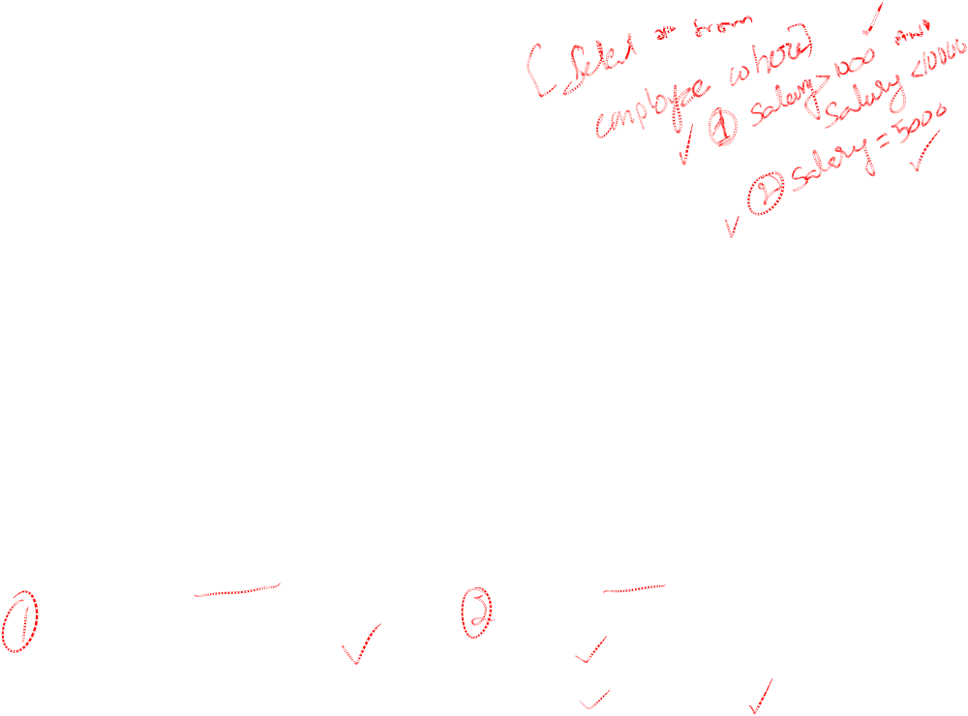
Introduction
As for any index, 3 alternatives for data entries k*:
  Data record with key value k
  <k, rid of data record with search key value k>
  <k, list of rids of data records with search key k>
Choice is orthogonal to the indexing technique used to locate data entries k*.
Tree-structured indexing techniques support both range searches and equality searches.
ISAM: static structure; B+ tree: dynamic, adjusts gracefully under inserts and deletes.
Notes:
2

Slide 3

Range Searches
``Find all students with gpa > 3.0’’
  If data is in sorted file, do binary search to find first such student, then scan to find others.
  Cost of binary search can be quite high.
Simple idea: Create an `index’ file.
k1
k2
kN
Index File
Page 1
Page 2
Page 3
Page N
Data File
Can do binary search on (smaller) index file!
Notes:
3

Slide 4
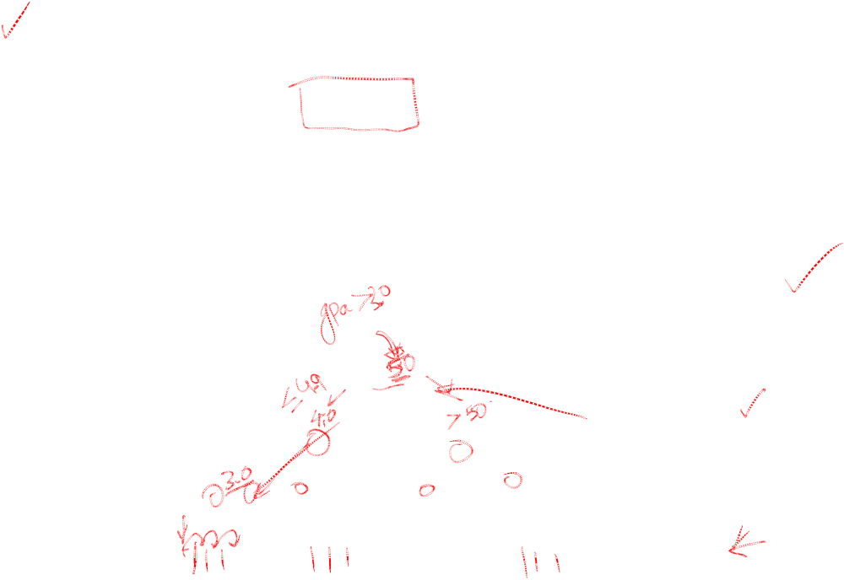
B+ Tree: The Most Widely Used Index
Insert/delete at log _{F} N cost; keep tree height-balanced. (F = fanout, N = # leaf pages)
Minimum 50% occupancy (except for root).
Supports equality and range-searches efficiently.
Index Entries
(Direct search)
Data Entries
("Sequence set")
Notes:
9

Slide 5
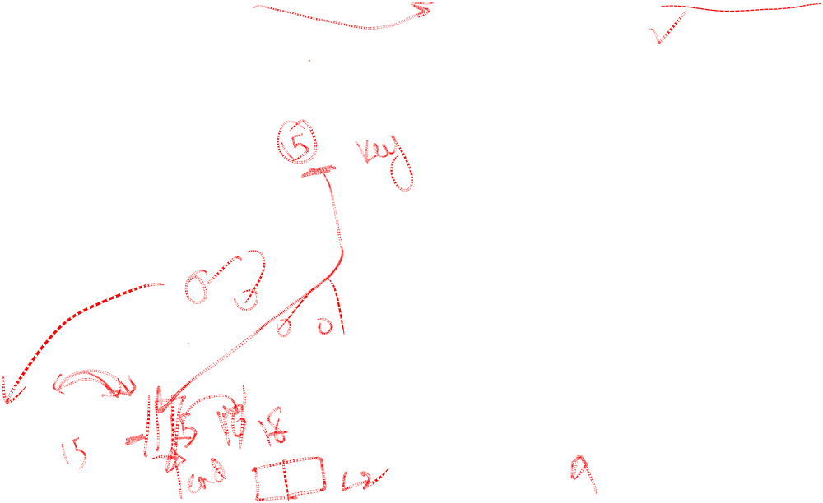
Example B+ Tree (order p=5, m=4)
Search begins at root, and key comparisons direct it to a leaf (as in ISAM).
Search for 5*, 15*, all data entries >= 24* ...
Root
p=5 because tree can have at most 5 pointers in intermediate node; m=4 because at most 4 entries in leaf node.
7
16
22
29
2*
3*
5*
7*
14*
16*
19*
20*
22*
24*
27*
29*
33*
34*
38*
39*
Based on the search for 15*, we know it is not in the tree!
Notes:
10

Slide 6
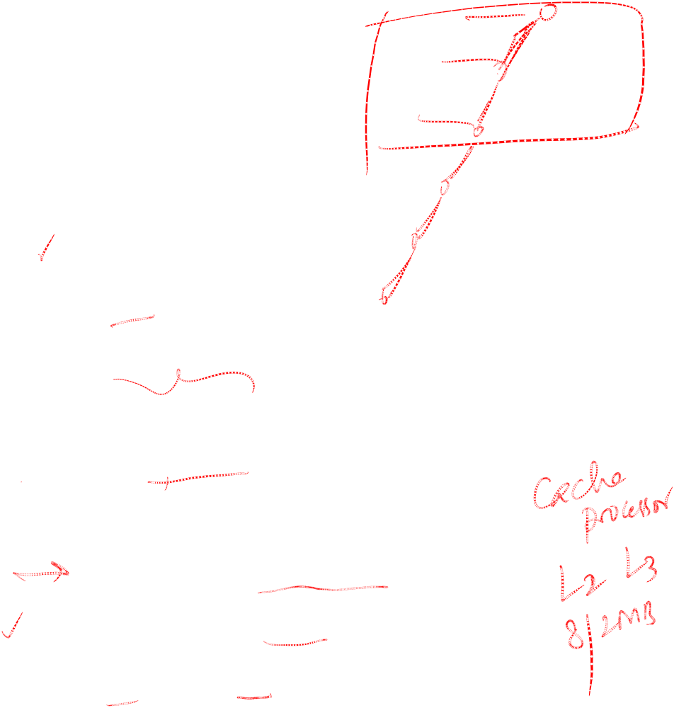
B+ Trees in Practice
Typical order: 200. Typical fill-factor: 67%.
  average fanout = 133
Typical capacities:
  Height 4: 133⁴ = 312,900,700 records
  Height 3: 133³ = 2,352,637 records
Can often hold top levels in buffer pool:
  Level 1 = 1 page = 8 Kbytes
  Level 2 = 133 pages = 1 Mbyte
  Level 3 = 17,689 pages = 133 MBytes

Slide 7

Inserting a Data Entry into a B+ Tree
Find correct leaf L.
Put data entry onto L.
  If L has enough space, done!
  Else, must split L (into L and a new node L2)
    Redistribute entries evenly, copy up middle key.
    Insert index entry pointing to L2 into parent of L.
This can happen recursively
  To split index node, redistribute entries evenly, but push up middle key. (Contrast with leaf splits.)
Splits “grow” tree; root split increases height.
  Tree growth: gets wider or one level taller at top.
Notes:
6

Slide 8

Inserting 8* into Example B+ Tree
Observe how minimum occupancy is guaranteed in both leaf and index pg splits.
Note difference between copy-up and push-up; be sure you understand the reasons for this.
Entry to be inserted in parent node.
5
(Note that 5 is
s copied up and
continues to appear in the leaf.)
2*
3*
5*
7*
8*
Entry to be inserted in parent node.
17
(Note that 17 is pushed up and only
appears once in the index. Contrast
this with a leaf split.)
5
13
24
30
Notes:
12

Slide 9

Example B+ Tree After Inserting 8*
Root
16
3
8
22
29
2*
3*
5*
7*
8*
14*
16*
19*
20*
22*
24*
27*
29*
33*
34*
38*
39*
Notice that root was split, leading to increase in height.
In this example, we can avoid split by re-distributing entries; however, this is usually not done in practice.
Notes:
13

Slide 10

Deleting a Data Entry from a B+ Tree
Start at root, find leaf L where entry belongs.
Remove the entry.
  If L is at least half-full, done!
  If L has only d-1 entries,
    Try to re-distribute, borrowing from sibling (adjacent node with same parent as L).
    If re-distribution fails, merge L and sibling.
If merge occurred, must delete entry (pointing to L or sibling) from parent of L.
Merge could propagate to root, decreasing height.
Notes:
14

Slide 11
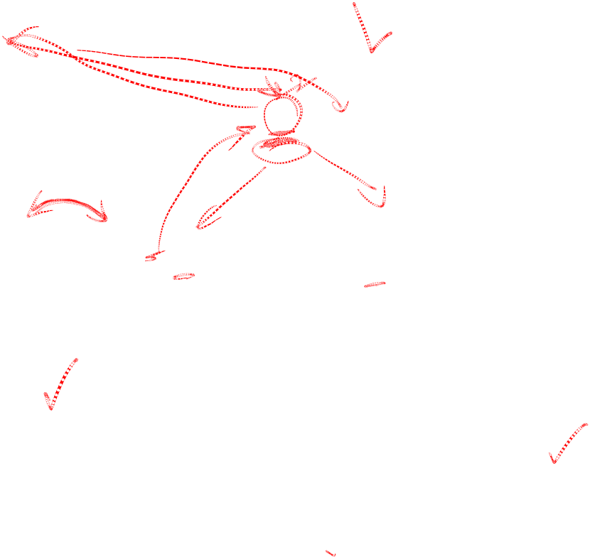
Example Tree After (Inserting 8*, Then) Deleting 19* and 20* ...
Root
16
3
8
24
29
2*
3*
5*
7*
8*
14*
16*
22*
24*
27*
29*
33*
34*
38*
39*
Deleting 19* is easy.
Deleting 20* is done with re-distribution. Notice how middle key is copied up.
Notes:
15

Slide 12
... And Then Deleting 24*
Must merge.
Observe `toss’ of index entry (on right), and `pull down’ of index entry (below).
29
22*
27*
29*
33*
34*
38*
39*
Root
3
8
16
29
2*
3*
5*
7*
8*
14*
16*
22*
27*
29*
33*
34*
38*
39*
Notes:
16

Slide 13
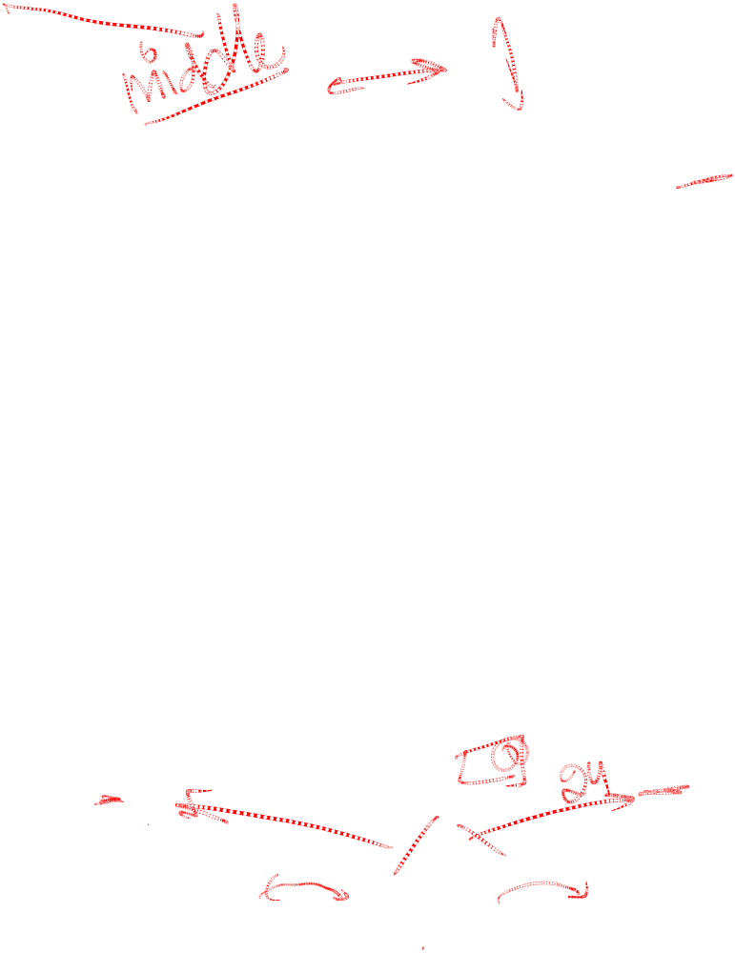
Example of Non-leaf Re-distribution
Tree is shown below during deletion of 24*. (What could be a possible initial tree?)
In contrast to previous example, can re-distribute entry from left child of root to right child.
Root
21
3
8
16
18
29
2*
3*
5*
7*
8*
14*
16*
17*
18*
20*
21*
22*
27*
29*
33*
34*
38*
39*
Notes:
17

Slide 14
After Re-distribution
Intuitively, entries are re-distributed by `pushing through’ the splitting entry in the parent node.
It suffices to re-distribute index entry with key 20; we’ve re-distributed 17 as well for illustration.
Root
16
3
8
18
21
29
2*
3*
5*
7*
8*
14*
16*
17*
18*
20*
21*
22*
27*
29*
33*
34*
38*
39*
Notes:
18

Slide 15
Clarifications B+ Tree
B+ trees can be used to store relations as well as index structures
In the drawn B+ trees we assume (this is not the only scheme) that an intermediate node with q pointers stores the maximum keys of each of the first q-1 subtrees it is pointing to; that is, it contains q-1 keys.
Before B+-tree can be generated the following parameters have to be chosen (based on the available block size; it is assumed one node is stored in one block):
  the order p of the tree (p is the maximum number of pointers an intermediate node might have; if it is not a root it must have between round(p/2) and p pointers)
  the maximum number m of entries in the leaf node can hold (in general leaf nodes (except the root) must hold between round(m/2) and m entries)
Intermediate nodes usually store more entries than leaf nodes

Slide 16
Summary B⁺ Tree
Most widely used index in database management systems because of its versatility. One of the most optimized components of a DBMS.
Tree-structured indexes are ideal for range-searches, also good for equality searches (log _{F} N cost).
Inserts/deletes leave tree height-balanced; log _{F} N cost.
High fanout (F) means depth rarely more than 3 or 4.
Almost always better than maintaining a sorted file
Self reorganizing (dynamic data structure)
Typically 67%-full pages at an average
Notes:
23

